Slide 1
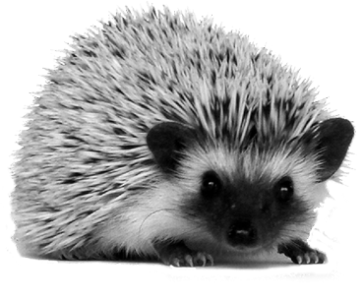
Hedgehog Class
Whaddon C of E School

Slide 2
Welcome!
Hedgehog Class is a mix of Reception and Year 1 children. As such, we follow both the Early Years Foundation Stage (EYFS) and the National Curriculum (NC).
Learning takes place in a variety of ways throughout the week:
Whole class carpet times
Separate Reception and Year 1 carpet times when appropriate
Child led learning (‘project time’) supported by adults
Small group work
1:1 work

Slide 3
Timetable Autumn Term (subject to change)
 | Monday | Tuesday | Wednesday | Thursday |  | Friday
8.50 | Arrival / Register Morning Tasks | Arrival / Register Morning Tasks | Arrival / Register Morning Tasks | Arrival / Register Morning Tasks |  | Arrival / Register Morning Tasks
9.05 | Collective Worship In Class | Collective Worship Bible Theme | Whole School Meeting or Circle Time/PHSE | Collective Worship Rev Dove |  | Collective Worship Celebration
9.25-9.50 Session 1a | Phonics and Fine Motor Skills Handwriting Spelling | Phonics | Phonics | Phonics Independent Learning | Forest School Year 1 | Phonics
9.50-10.30 Session 1b |  | Guided Reading Groups Individual Readers Skills work | Writing including Fine Motor Skills Handwriting | Independent Learning Reception |  | Guided Reading Groups Individual Readers Skills work
BREAK |  | KR Duty | BA Duty | LGA Duty |  | KR Duty
10.50- 11.50 Session 2 | Maths | Maths | Maths | Maths Reception Music Reception | Forest School Year 1 | Music Year 1 | PE Reception
LUNCH
1.00-2.30 Session 3 | RE and Circle Time - Langauge Skills | Mantle Topic Work with Independent Learning | Mantle Topic Work with Independent Learning | Phonics and Fine Motor Skills Handwriting Spelling |  | Maths Year 1 PE Year 1 | Forest School Rec
2.30- 3.00 | Story | Story | Story | Story |  | Story

Slide 4
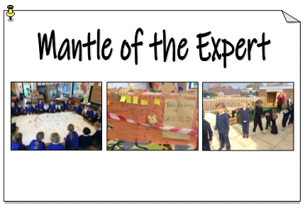
Mantle of the Expert
Later in the year, some of our learning will take place through Mantle of the Expert. This is an approach to education that uses imaginary contexts to generate purposeful and engaging activities for learning. It uses a range of drama techniques to immerse children into the fictional context and so all of the learning activities have a purpose.
The children become an 'expert' team. They have a client who sets them a task (the commission) or several different tasks. They solve problems together and, as needed, learn facts and information as they go. You can see some of the previous projects we have undertaken at Whaddon on the school website.
You can find out more on the Mantle of the Expert website here.

Slide 5
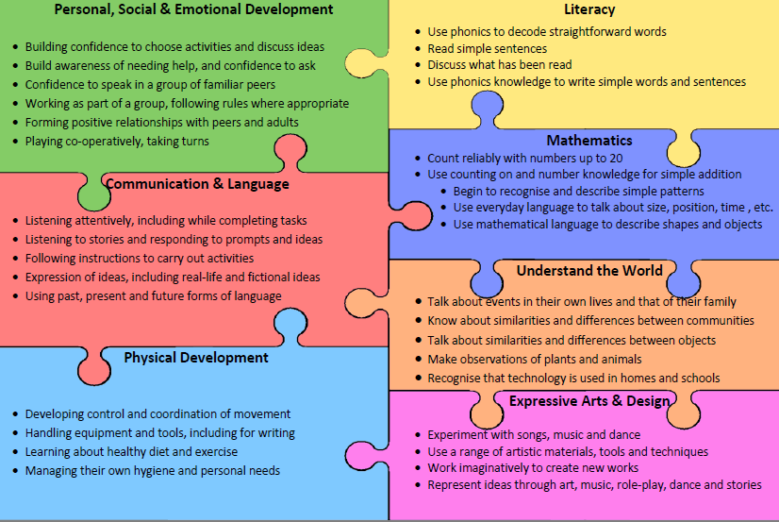
The Early Year Foundation Stage Framework
Prime Areas
Specific Areas

Slide 6
The National Curriculum in Year 1: Core subjects
Reading Applying phonics to sound out words Sight reading for fluency Discussing books beyond their decoding ability Understanding key events and characters Becoming familiar with fairy tales and story structure Using non fiction books | Writing Spelling using phonics Spelling common exception words Handwriting Composing texts Punctuation – finger space, full stop, capital letter, exclamation mark, question mark Using ‘and’ | Maths Numbers and Place Value Addition and Subraction Multiplication and Division Fractions Shape Position and Direction Length and Height Weight Capacity Time

Slide 7
The National Curriculum in Year 1: Non-Core subjects
Art & Design Using a range of materials Drawing, painting and sculpture Considering pattern, texture, colour, line, shape and form Learning about different artists | Computing Algorithms Creating simple programmes Creating and storing digital content Using the internet and e-safety | Design Technology Design Make Evaluate Technical knowledge Cooking and nutrition | Geography Locational knowledge Place knowledge Human and physical knowledge Geographical skills and fieldwork
History Chronology Historical vocabulary Changes within living memory Significant events Significant individuals Their own locality | Music Songs and chants Tuned and untuned instruments Listening to a range of music Experimenting with and combining sounds | P.E. Developing a range of skills Master basic movements Develop agility, balance and co-ordination Participate in team games Perform simple dan ces | Science Scientific investigation Plants Animals including humans Everyday materials Seasonal changes

Slide 8
Autumn 1: Autumn Adventures
Possible curriculum opportunities (may change with children’s interests)
Writing:
Labels
Signs
Posters
Speech bubbles
Geography/UtW
Seasonal changes
Local place knowledge
Woodland maps
Art/ EAaD
Leaf rubbing
Bark rubbing
Oil pastel animals
Painting animals
Andy Goldsworthy
Science/ UtW
Woodland habitats
Animals’ needs
Naming animals
Naming trees
D.T/ EAaD
Outdoor building:
animal homes
Outdoor building:
role play woodland
R.E
The Creation Story
Computing/ UtW
Photographs
Filming animals
Busy Things
Music and P.E.
Taught discretely
by specialist teachers

Slide 9
Reading
Children will all have a reading book from the start of the year. I will send home some ideas for helping your child with their reading at home. They will read with an adult at least once per week.
At school, we will share a lot of stories together. Some of these will be ‘big books’ so children can see the print as we read and follow along with it.
Year 1 children will take part in Secret Book Club once per week; this will boost their reading and comprehension skills by reading aloud with their friends in a small group and discussing what they have read.
There will be books all around the classroom for children to access during their own learning time – they will be encouraged to enjoy books and use them to find out information.

Slide 10
Writing
For children to enjoy writing it needs to be purposeful. The children’s written skills will be built up in a range of different ways, which will change as the year goes on, including:
Phonics sessions, learning to read and write sounds in order to write
Fine motor and gross motor activities to build strength and stamina for writing
Pre-writing activities (lines and patterns)
Handwriting practice
Whole class shared writing (an adult writes with the children’s help)
Modelled writing (an adult writes with children watching)
Independent writing opportunities around the classroom (linked to the children’s interests)
Small group writing activities

Slide 11
Maths
Children will participate in whole-class and small group maths activities. They will also have lots of opportunity to apply their maths during their independent project time.
We follow the ‘Singapore Maths’ approach of teaching mathematics. This involves:
focussing on teaching for mastery: children don’t just ‘know’ the maths – they understand, can talk about and apply the maths
use of the concrete, pictorial and abstract approach: children need to have access to concrete resources for any mathematical concept they will be learning before moving to pictorial and then more abstract methods; for example, they might use real conkers to add three and five, before drawing conkers and then finally understanding what 3 + 5 means.
teaching simple maths facts for fluency

Slide 12
Helping at Home
Hearing your child read every day (little and often is best)
Reading to your child – a range of fiction and non-fiction
Playing with maths – particularly learning maths facts
Lots of activities to develop fine motor skills
Phonics activities online
(more information about helping at home will be going home early in the Autumn term)

Slide 13
Adults in Hedgehog Class
Hedgehog Class is supported by:
Mrs Rudiger (class teacher) Mrs Gyau-Awuah and Mrs Abery (teaching assistants)
If you would like to speak to Mrs Rudiger, please email the office or catch her after school to ask for a mutually convenient time to talk.

